Slide 1
GOA Pacific cod
Species | 2023 catch | ABC 2023 | ABC 2024 | Change
 | 131,892 | 160,301 | 242,292 | up 81,991 | (51%)
 | 14,883 | 24,634 | 32,272 | up 7,638 | (31%)
 | 22,746 | 40,502 | 47,146 | up 6,644 | (16%)
 | 2,017 | 119,497 | 124,494 | up 4,997 | (4%)
 | 9,248 | 119,485 | 119,249 | down 236 | (0%)
 | 36,943 | 57,519 | 59,527 | up 2,008 | (3%)
 | 462 | 4,700 | 4,700 | same | (0%)
 | 2,741 | 6,563 | 6,036 | down 527 | (8%)
 | 1,777 | 4,891 | 4,891 | same | (0%)
 | 154 | 980 | 980 | same | (0%)
 | 222,863 | 539,072 | 641,587 | up 102,515 | (19%)
Pollock
Pacific Cod
Sablefish
Flatfish
Arrowtooth flounder
Rockfish
Atka mackerel
Skates
Sharks
Octopus
Total
Notes:
Pollock
Pacific Cod
Sablefish
Flatfish
Arrowtooth flounder
Rockfish
Atka mackerel
Skates
Sharks
Octopus
Total

Slide 2
GOA Pacific cod ESP report card
Kalei Shotwell presented the GOA Pacific cod ESP report card for 2023
A full ESP is scheduled for 2025.
As with pollock, the Team discussed CEATTLE model and indicator analyses
Noted that the CEATTLE model will include more stocks and more predators in the future and may be more generally applicable

Slide 3
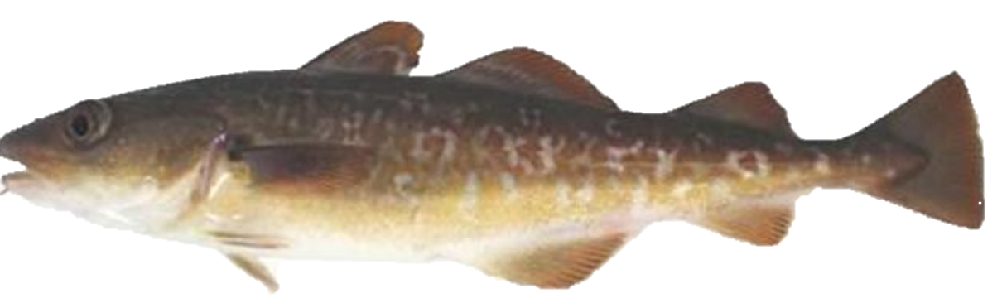
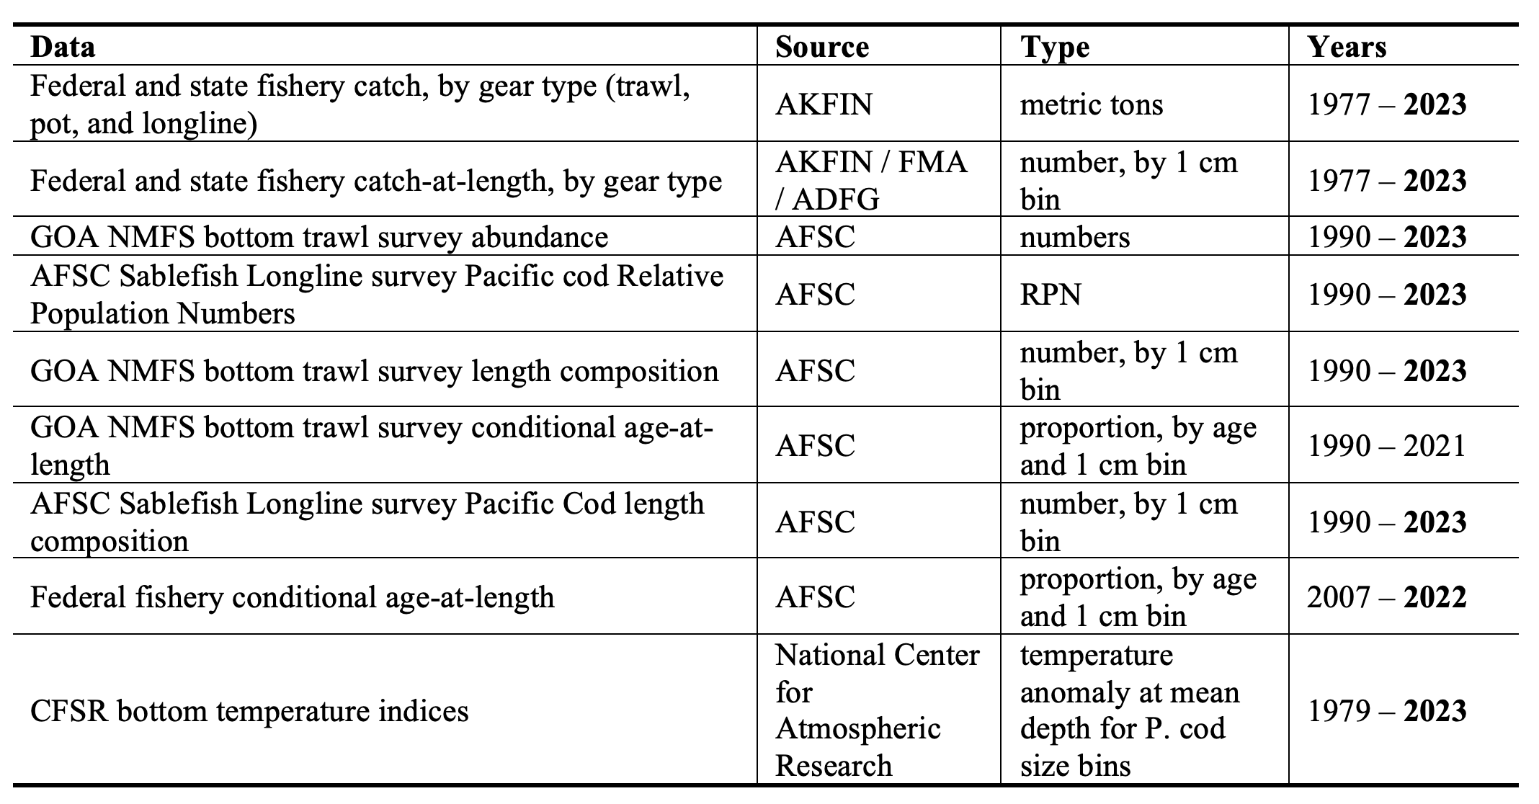
GOA Pacific cod data

Slide 4
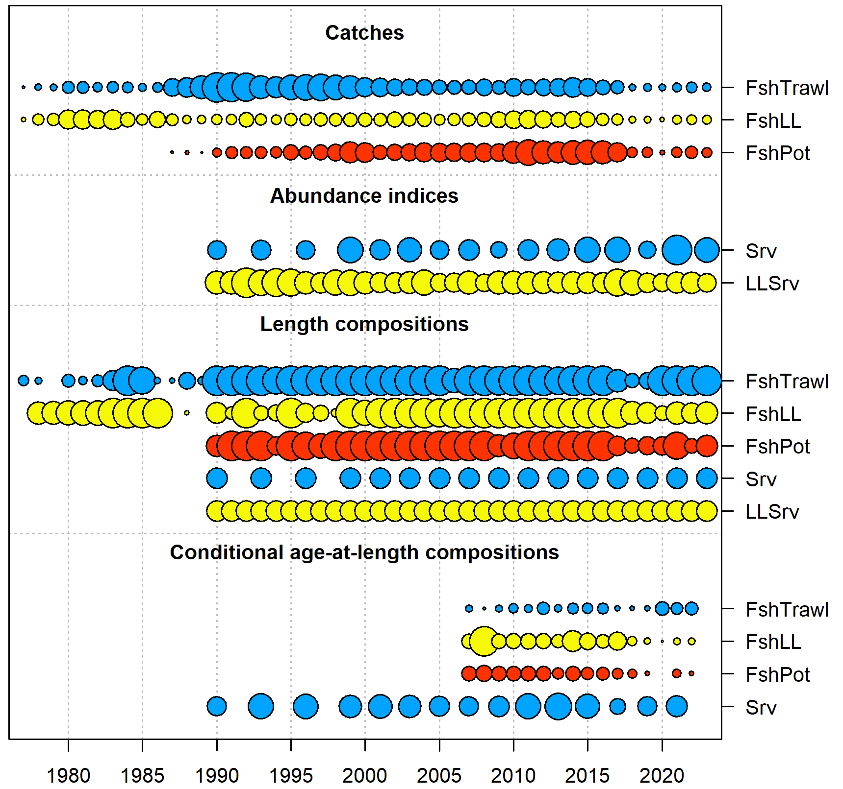
GOA Pacific cod data

Slide 5
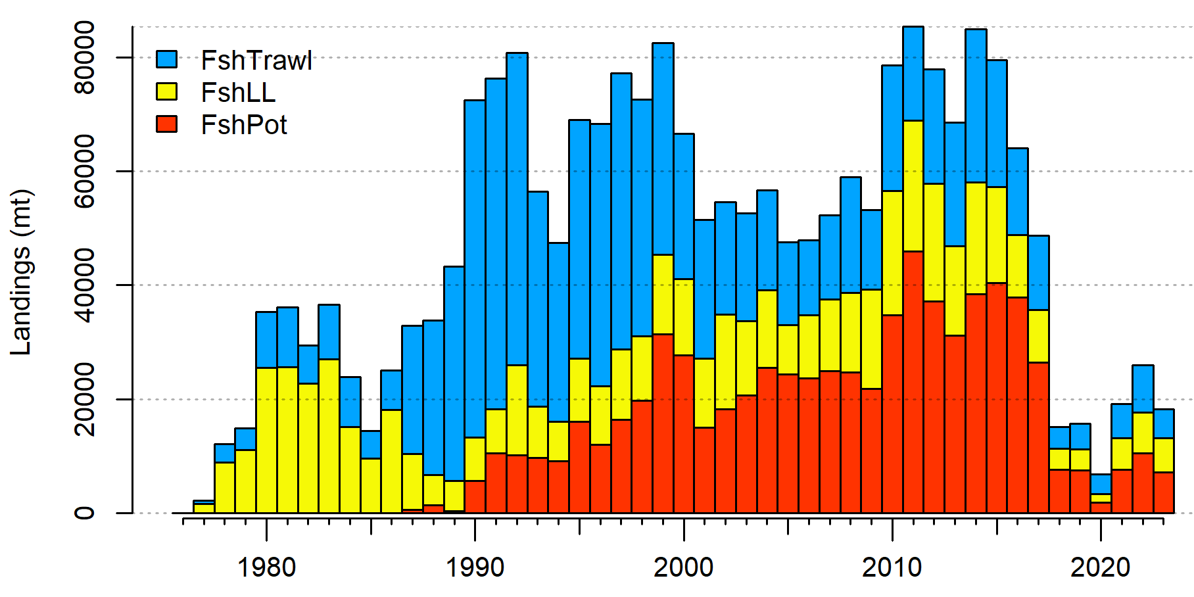
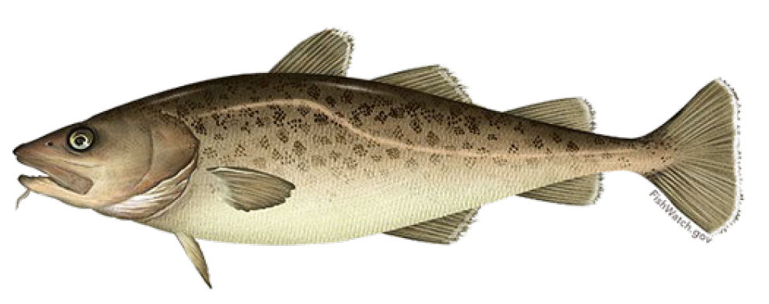
GOA Pacific cod data
Decreased since 2022
Pot majority > LL > Trawl
Large jig increase

Slide 6
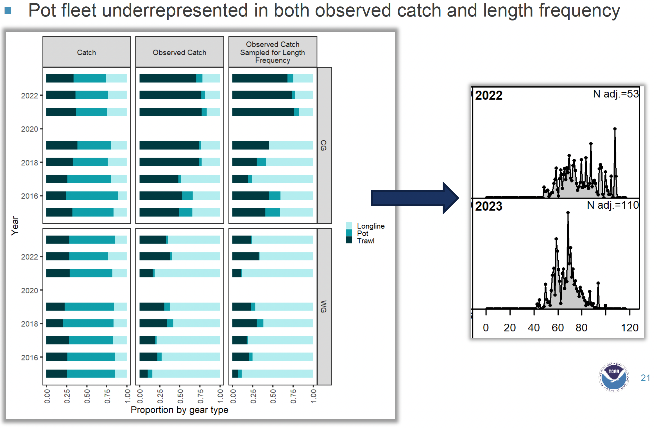
GOA Pacific cod data issues

Slide 7
GOA Pacific cod assessment
Correction on conditional age-at-length weight
Tested catchability covariate
Evaluated sampling
Responded to Plan Team and SSC comments

Slide 8
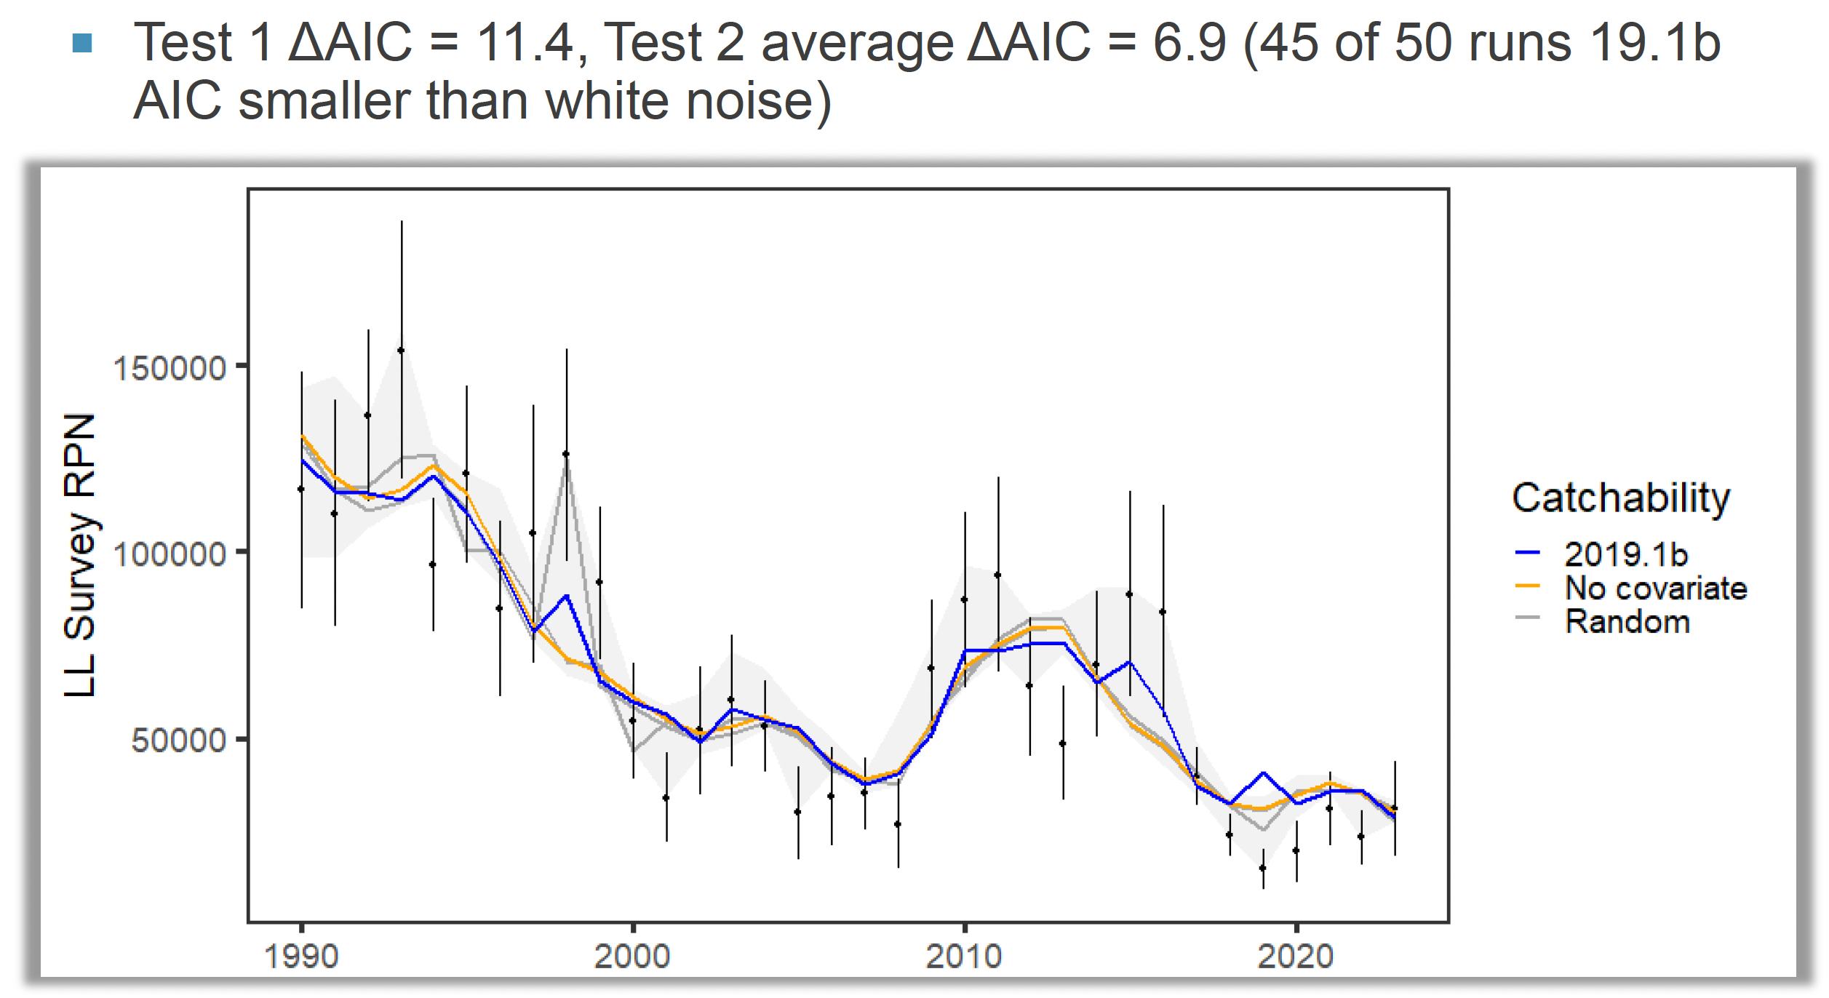
GOA Pacific cod assessment: test of LL survey catchability covariate
Conclusion:
Including covariate improved model

Slide 9
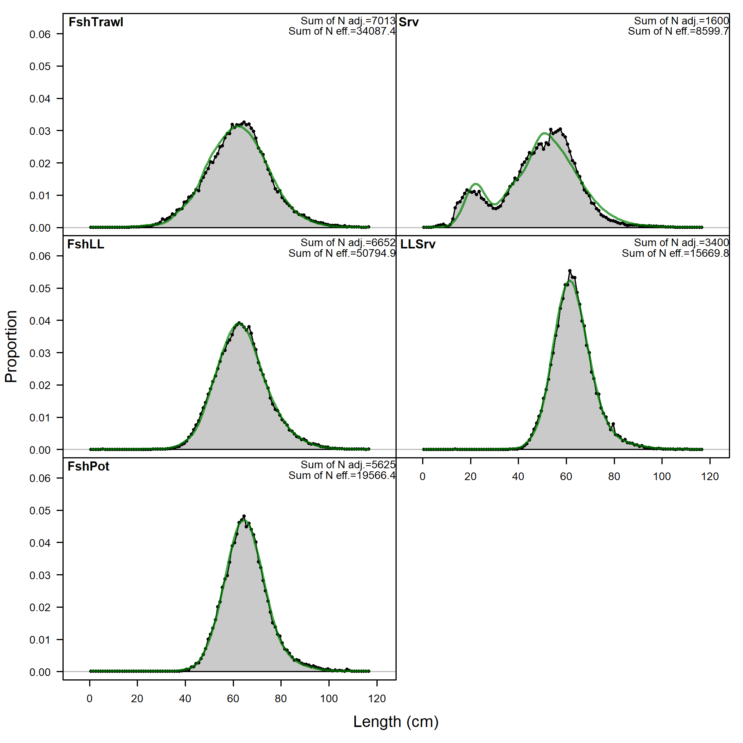
GOA Pacific cod assessment
In general, model fit to length comp data reasonably well
Slight misfit for survey length comp

Slide 10
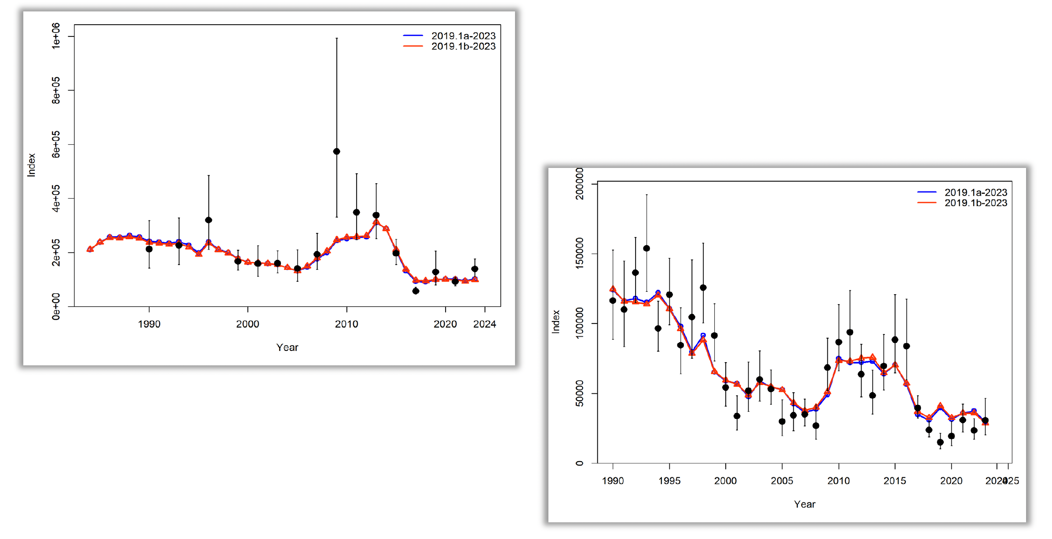
GOA Pacific cod: changes relative to 2022 configuration
Trawl survey
Fit to data
Longline survey
Notes:
Trawl survey

Slide 11
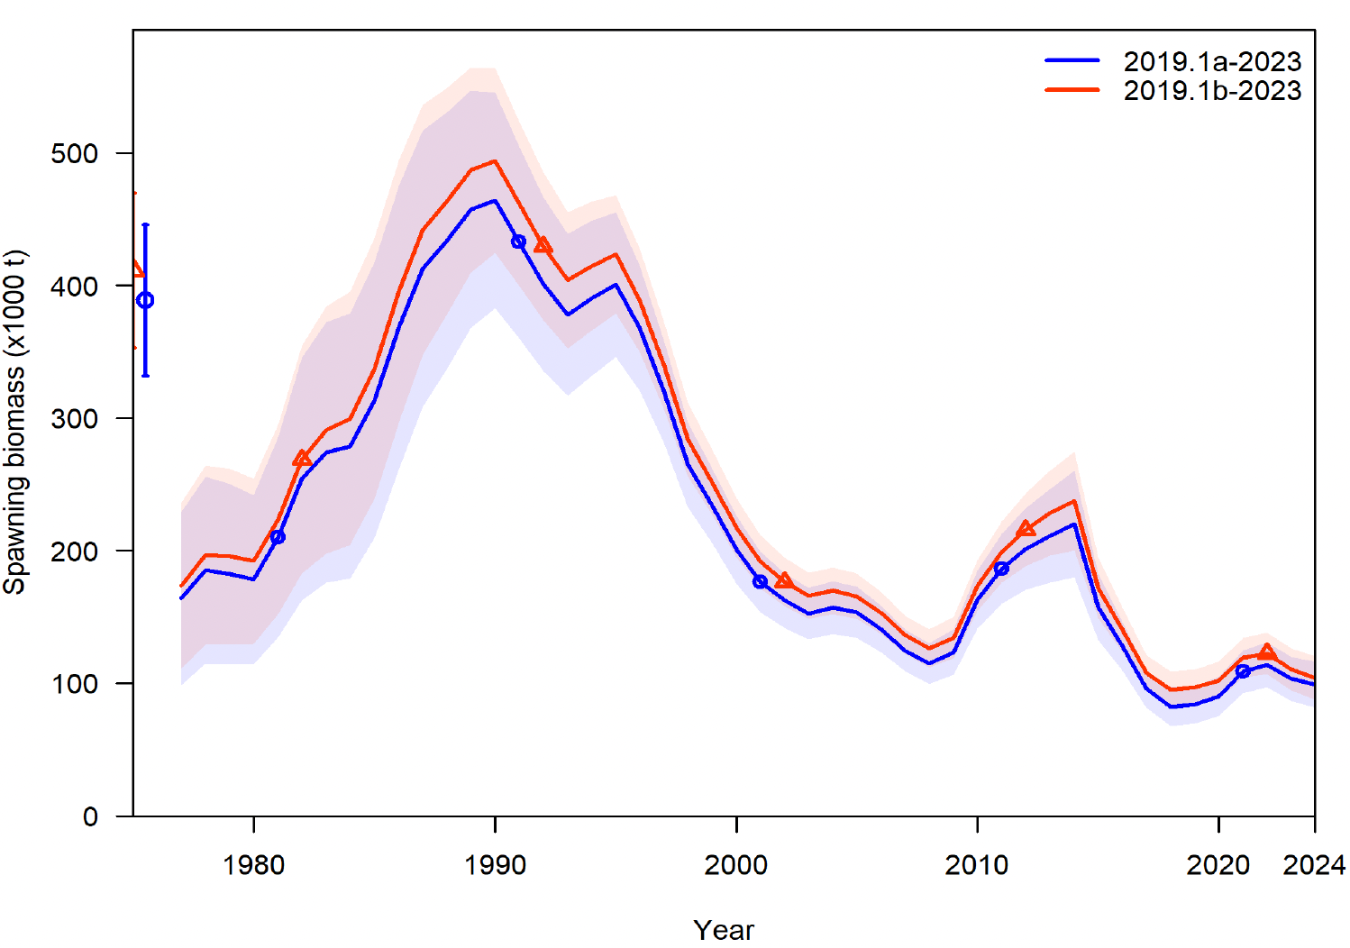
GOA Pacific cod: changes relative to 2022 configuration

Slide 12
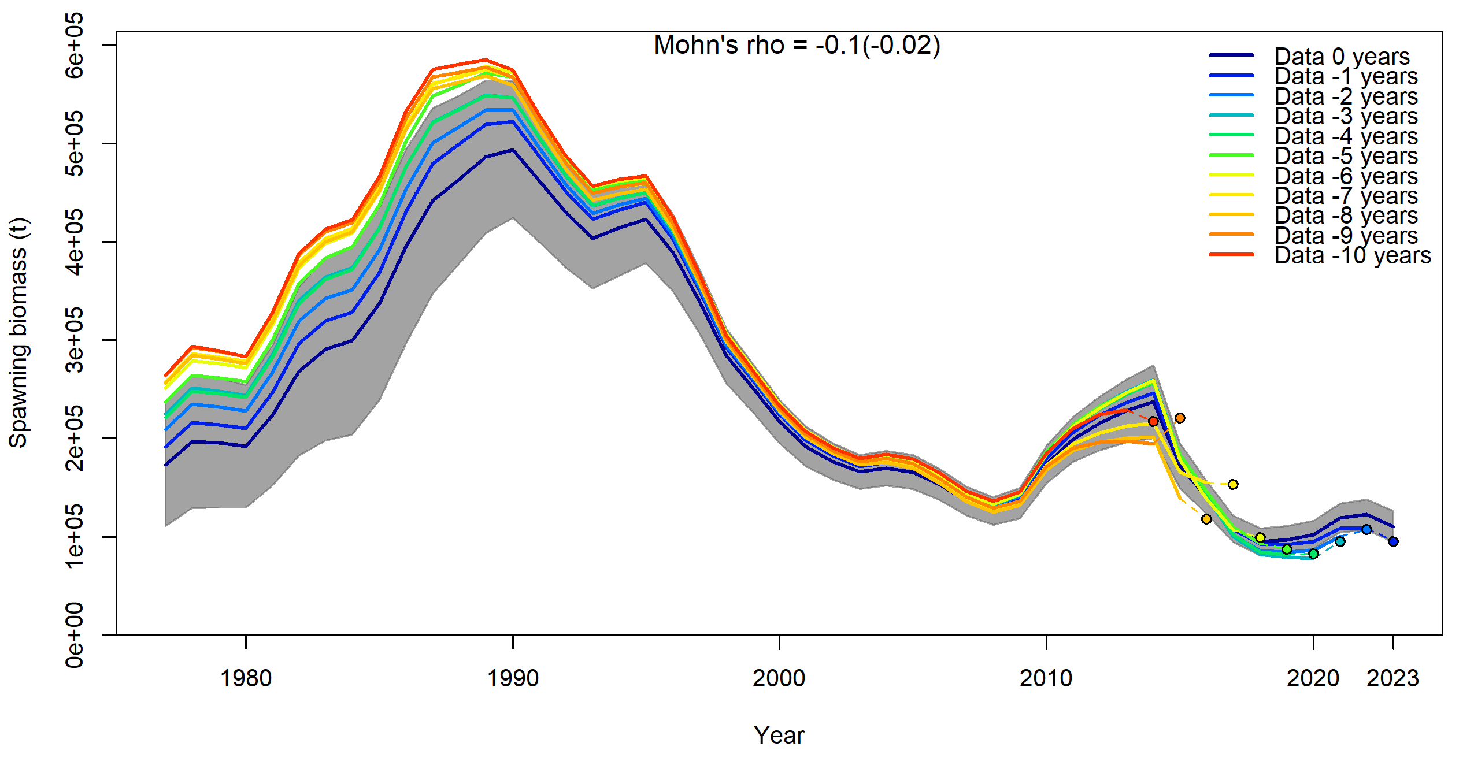
GOA Pacific cod retrospectives

Slide 13
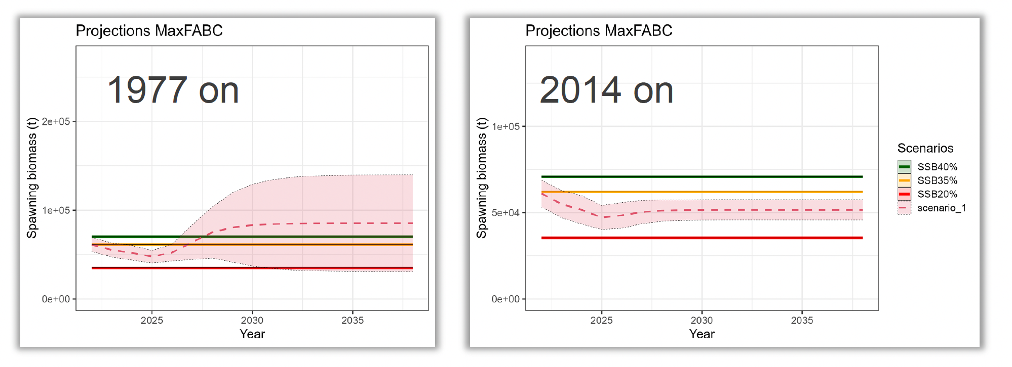
GOA Pacific cod projection considerations
Use mean recruitment from 2014 on in projections
Stock can not attain current reference point

Slide 14
GOA Pacific cod summary
2024 SSB 51,959 t
15% below B_{MSY} proxy 61,315 t
On the “ramp” of FMP control rule: ~42% of F_{MSY} proxy
Uncertainty in projections adequately covered by FMP control rule
Declines expected to continue in near term

Slide 15
GOA Pacific cod: Team Discussion
The Team recommended that sufficient samples be processed and analyzed so that the resulting data can be used in the assessment.
Maturity samples remain unprocessed
The Team noted the work devoted to developing posterior distribution
The Team agreed with the authors’ recommended model, 19.1b, and the authors’ recommended OFL and ABCs, with no reduction from the maximum permissible ABC.

Slide 16
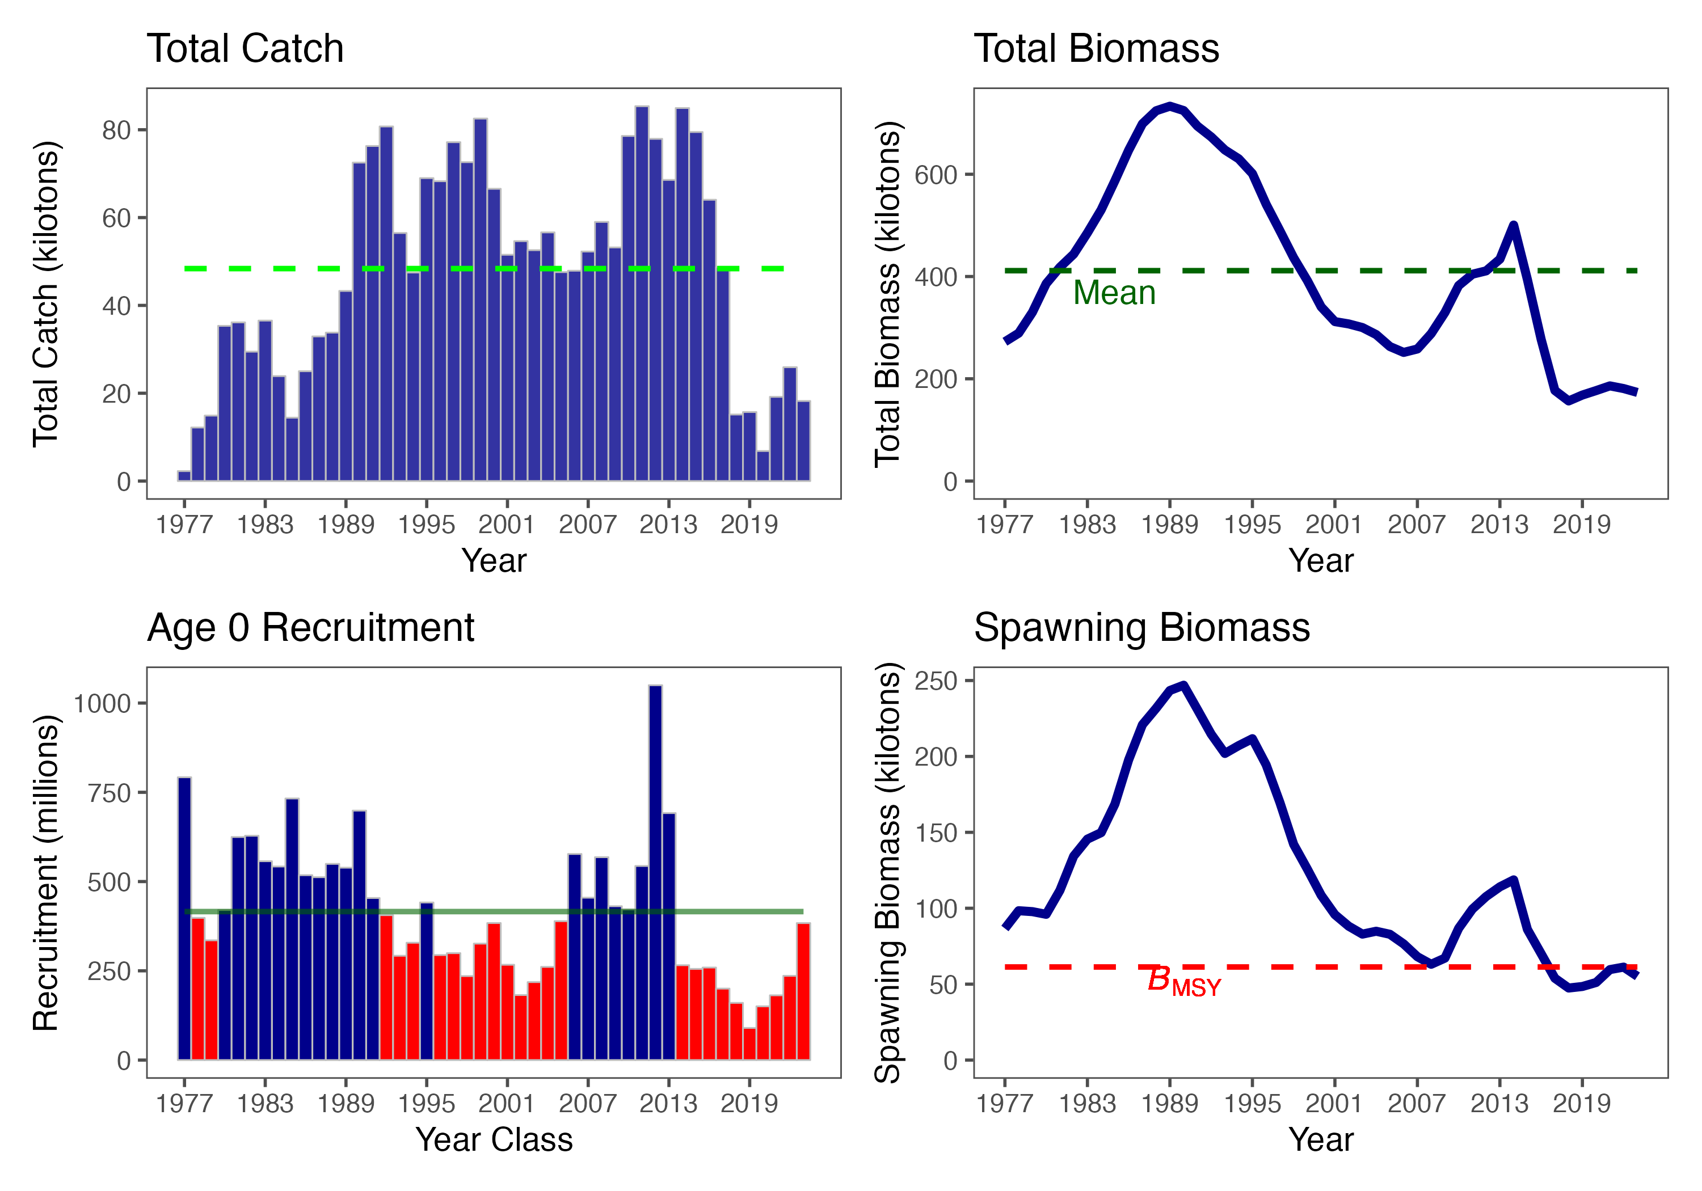
GOA Pacific cod

